Slide 1

AtliQ Hospitality Analysis Report

Slide 2

Introduction
Atliq Grands, a prominent player in the Indian hospitality industry for over 20 years, is facing challenges due to strategic moves by competitors and ineffective management decisions.
To regain market share and revenue in the luxury/business hotels category, the managing director has decided to incorporate Business and Data Intelligence.
Without an in-house data analytics team, they have hired a third-party service provider to analyze historical data and provide actionable insights.
The goal is to leverage data-driven strategies to enhance decision-making and improve overall performance.

Slide 3

Problem Statement
Atliq Grands, a chain of five-star hotels across India, is losing market share and revenue in the luxury/business hotels category due to strategic moves from competitors and ineffective decision-making in management.
To regain their market share and revenue, the managing director wants to incorporate “Business and Data Intelligence.”
However, they lack an in-house data analytics team and have decided to hire a third-party service provider to gain insights from their historical data.

Slide 4
Objective
Analyze Historical Data: Utilize historical data to identify trends and patterns in revenue, occupancy rates, and customer ratings.
Strategic Insights: Provide actionable insights to improve decision-making and strategic planning.
Market Share Recovery: Develop strategies to regain market share and enhance revenue in the luxury/business hotels category.
Performance Metrics: Establish key performance indicators (KPIs) to monitor and evaluate the effectiveness of implemented strategies.

Slide 5

Details of Data
The Dataset includes 5 CSV files named as:
dim_date.csv
dim_hotels.csv
dim_rooms.csv
fact_aggregated_bookings.csv
fact_bookings.csv

Slide 6

Main KPIs
Revenue - Sum of revenue_realized
Total Bookings - Count of booking_id in fact_bookings
Average Rating - Average of ratings_given
Total Capacity - Sum of capacity
Total Succesful bookings - Sum of successful_bookings from fact_bookings

Slide 7

Main KPIs
Occupancy % - Ratio of Total Successful Bookings to Total Capacity
Total Cancelled Bookings - Count of booking_id in which
booking_status = "Cancelled“
Cancellation Rate - Ratio of 'Total Cancelled Bookings' to 'Total Bookings'

Slide 8

Dashboard

Slide 9
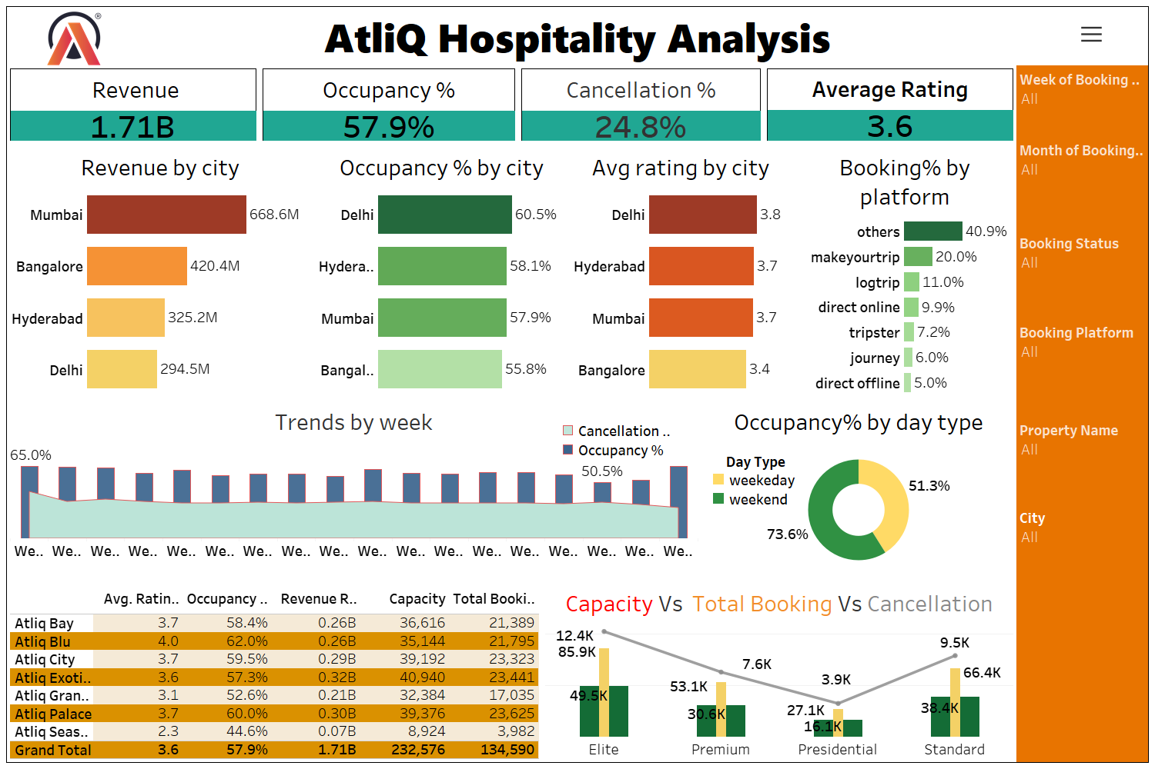

Slide 10
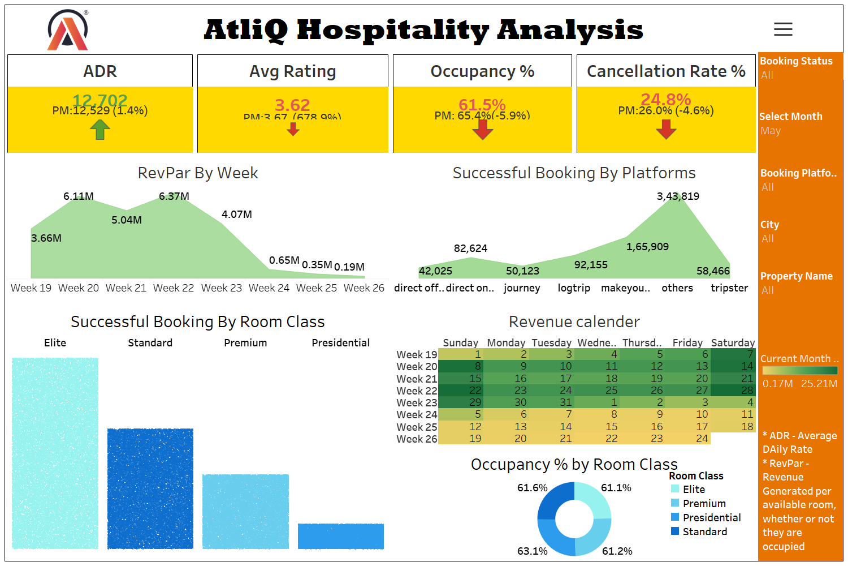

Slide 11

Thank You

